Slide 1
Breast Cancer Prediction
Nate Rodriguez 2023

Slide 2
Table of Contents
01
02
03
About the Disease
About the Dataset
Question 1
04
05
Question 2
Question 3
Variable descriptions, cleaning, etc.
Background info on Breast Cancer.
Identifying important predictors.
Clustering the Data.
Prediction Models.

Slide 3
01
About the Disease
Background info on Breast Cancer.

Slide 4
Introduction
Breast cancer is a significant health issue affecting millions of individuals globally. It is a malignant tumor that forms in the breast tissue, typically originating from the milk ducts or lobules. Breast cancer is a complex disease with various subtypes and stages, and it poses a substantial burden on individuals and society.

Slide 5
Breast Cancer effects
266,400 a year.
2,400 of these cases are males, while 244,000 are women.

Slide 6
Advantages of Machine Learning in Breast Cancer Prediction
Machine learning models can assist dermatologists in diagnosing skin cancer accurately and efficiently.
Automated analysis reduces the risk of human error and provides a standardized approach to diagnosis.
Improved efficiency allows dermatologists to focus more on patient care and treatment planning.

Slide 7
02
About the Data
Variable descriptions, cleaning, etc.

Slide 8
About the Data
Source: University of Wisconsin, Clinical Science center.
Variables are measurements taken from the cell, including:
Data Type
Radius
Texture
Perimeter
Area
Smoothness
Compactness
Concavity
Symmetry
Fractal dimension
Diagnosis
Float
Float
Float
Float
Float
Float
Float
Float
Float
Object ( M or B)

Slide 9
Data (Cont.)
Shape: 569 observations of 11 variables.
Prevalence
37.3%
Outcome Variable: Diagnosis
Of the cells are classified as malignant, or dangerous.
Malignant indicating dangerous.
Benign indicating safe.

Slide 10
Data Cleaning and Preparation
Read in dataset.
Map Diagnosis to 0’s and 1’s (M = 1, B = 0)
Check data types.
Check for NA values.

Slide 11
03
Question 1
What variables are the best predictors of diagnosis?

Slide 12
Approach
Lasso
View Results
Conclusions
Perform a Lasso Model, shrinking variables to 0 to identify most significant variables
Interpret the results to make a conclusion.
View accuracy and coefficients.

Slide 13
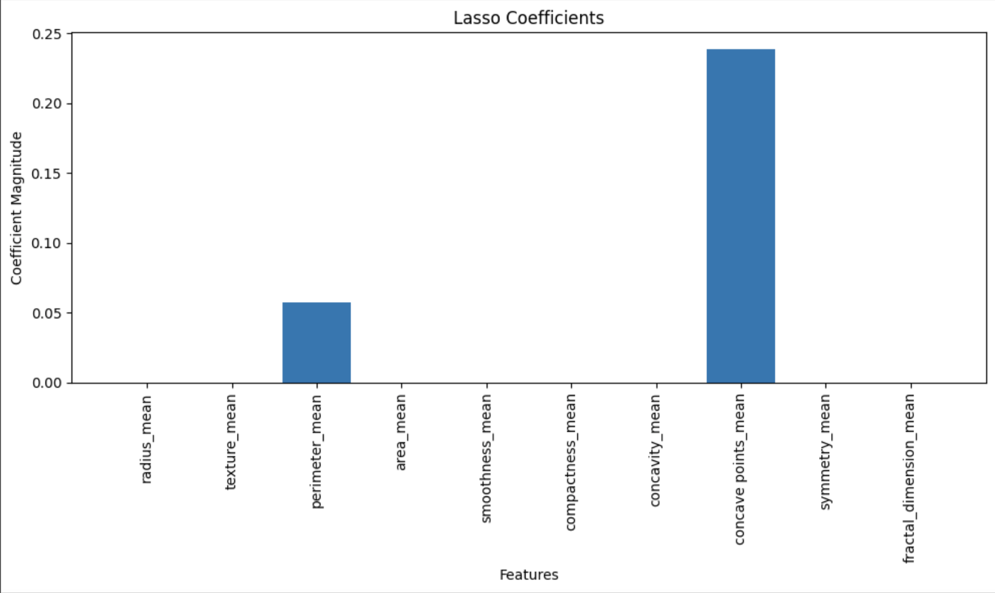
Lasso Model
Hyperparameters: Alpha = 0.01
Model Accuracy:
0.5132
Conclusions:
Concave points_mean and perimeter_mean appear to have a more significant effect on diagnosis.
An accuracy of 51.32% is not great, especially considering the topic of Breast Cancer.
R = 0.85, strong postive correlation.
*Will investigate later with logistic regression…

Slide 14
04
Question 2
What is the most successful method of clustering the data on area and symmetry?

Slide 15
Approach
K-Means
Hierarchical Agglomerative
By using distance from other points, K-means clusters the data by similarity to other points.
Starts with each data point as its own cluster and gradually merges similar clusters until a single overarching cluster is formed.

Slide 16
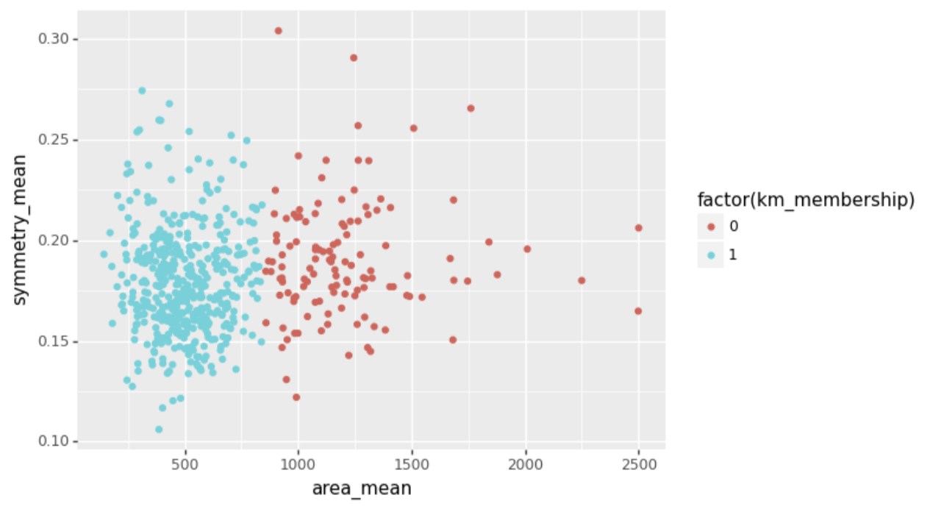
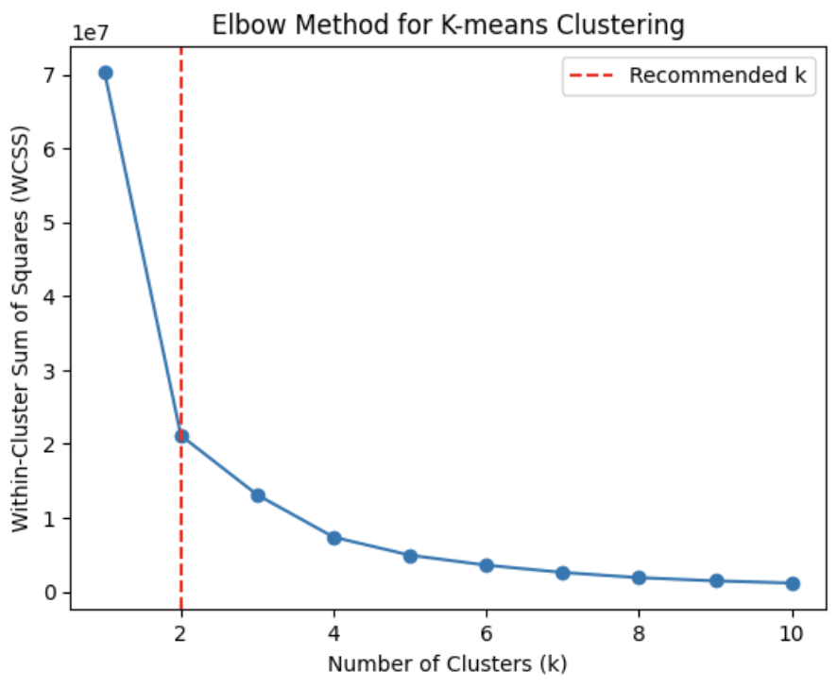
K-Means Model
Hyperparameters:
# of clusters = 2
Silhouette Score:
0.6998
Conclusions: ~.70 silhouette indicates fairly well-defined clusters. Clustered into two groups: smaller and larger cells.

Slide 17
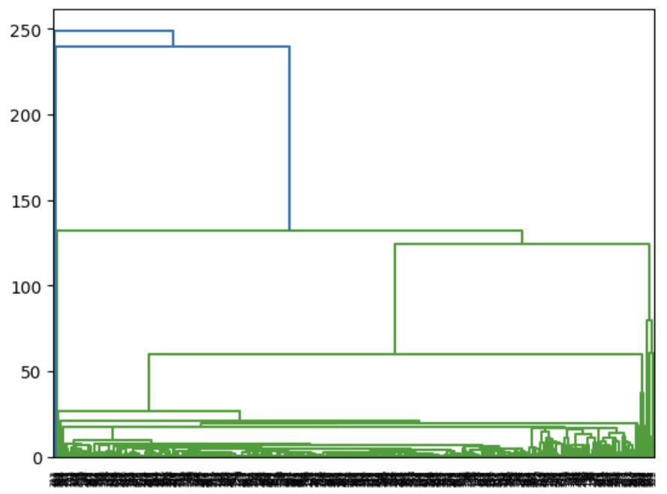
Hierarchical Agglomerative Model
Hyperparameters:
Single Linkage
Silhouette Score:
0.7818
Conclusions:
~.78 silhouette indicates well-defined clusters. Strong cohesion and separation between clusters.
Single linkage was chosen in order to capture elongated clusters and non-convex shapes present in the data.

Slide 18
05
Question 3
What model performed the best when predicting diagnosis?

Slide 19
Approach
KNN Model
Logistic
Neural Network
This supervised machine learning model will classify data points through clusters based on “K” nearest neighbors.
This regression model predicts diagnosis based on all features. Can be used to help identify important variables.
Predicts by taking in input data and processing it through multiple interconnected layers of “neurons”. These neurons learn patterns and relationships within the data to make predictions.

Slide 20
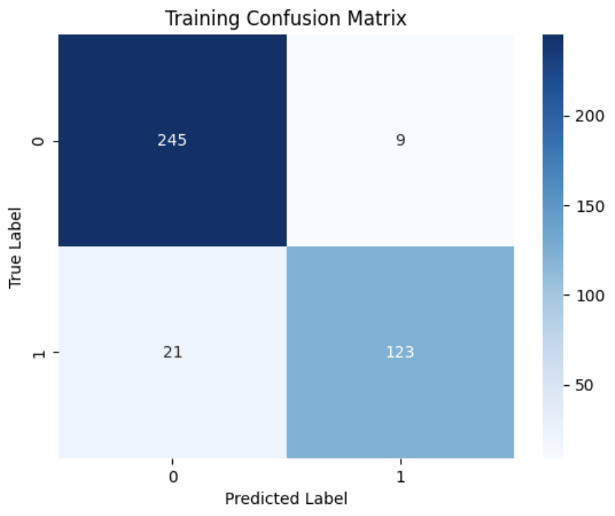
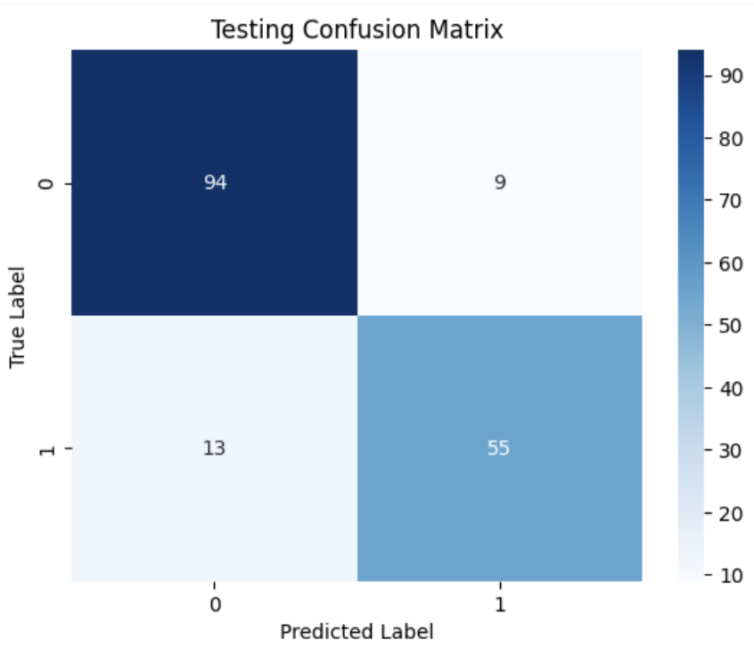
KNN Model
Hyperparameters:
# of neighbors = 5
Test Size:
0.30
Conclusions:
GridSearch was used to find ideal # of neighbors.
High accuracy, with low number of false positives/false negatives, indicating high specificity and sensitivity.
Variation of between train and test accuracy is low, indicating that our model is NOT overfit.
Train Accuracy:
0.9246
Test Accuracy:
0.8713

Slide 21

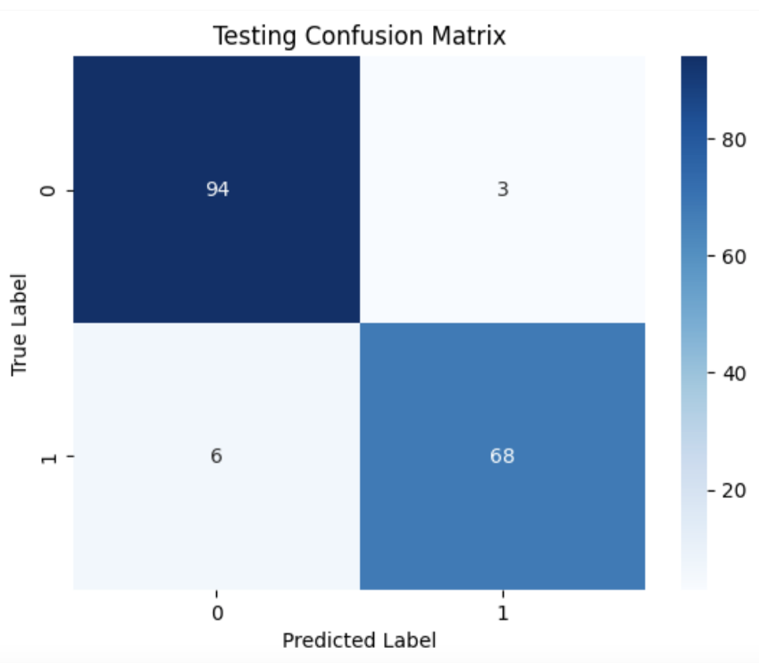
Logistic Model
Hyperparameters:
None
Test Size:
0.30
Conclusions:
Very high accuracy, with low number of false positives/false negatives, indicating high specificity and sensitivity.
Variation of between train and test accuracy is low, indicating that our model is NOT overfit.
Train Accuracy:
0.9472
Test Accuracy:
0.9474
Concave points_mean had the highest odds coefficient, meaning

Slide 22
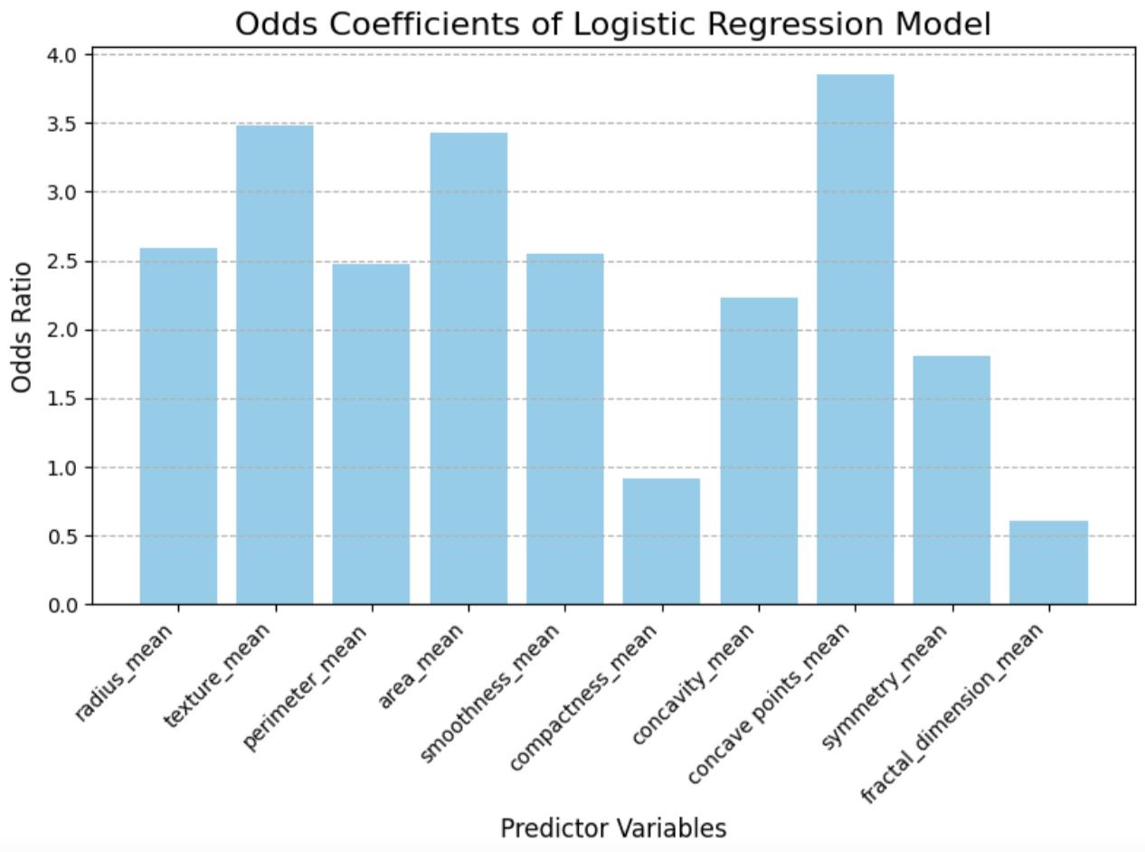
Logistic Model (Cont.)
Conclusions:
Concave points_mean has a 3.86 odds ratio, meaning a 1 unit increase in the variable makes it 3.86 times more likely that the cell is malignant.
Also note that the coefficients below 1 decrease the likelihood of a cell being malignant.

Slide 23
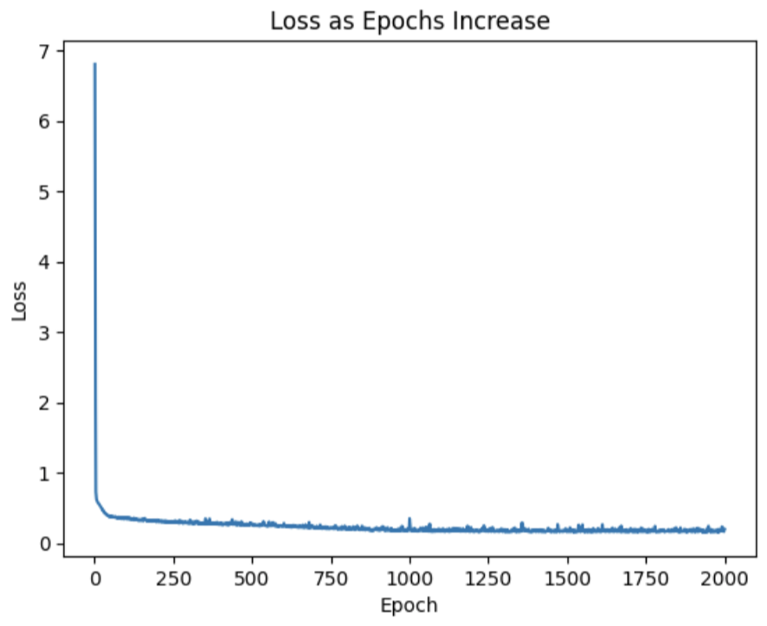
Neural Network
Hyperparameters:
Epochs: 2000
Learning Rate: 0.001
Batch Size: 32
Loss Function: BCELoss
Optimizer: Adam
Train Acc: 0.9523
Test Acc: 0.9484
Train Loss: 0.1123
Test Loss: 0.1289
Conclusions:
Extremely accurate, with no sign of overfitting - - as seen through accuracy and loss.
Convergence occurs shortly after epoch 1500, however, it was not computationally expensive, nor did it cause overfitting, to increase epochs to 2000.
Test Size: 0.30
Activation Function:
Sigmoid, ReLu

Slide 24
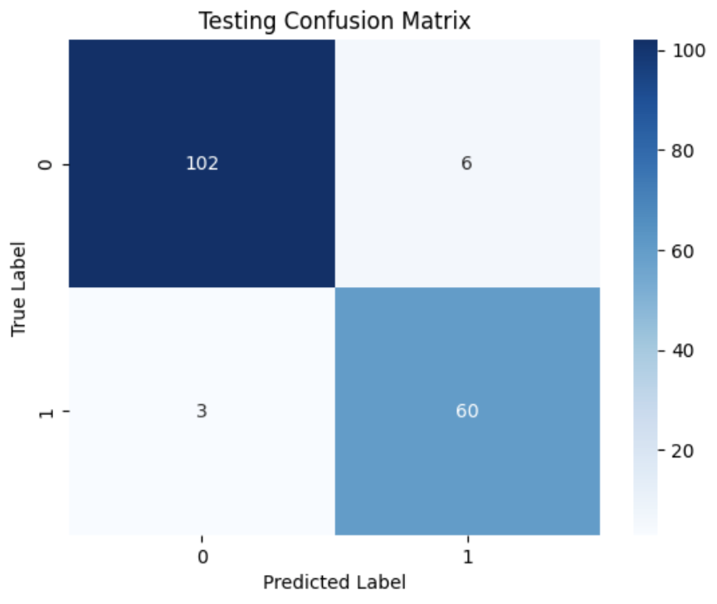
Neural Network (Cont.)
Test Sensitivity (True Positive): 0.9524
Test Specificity (True Negative): 0.9444
The model has a true positive rate of 95%, demonstrating 3 false negatives.
The model has a true negative rate of 94%, demonstrating 6 false positives.

Slide 25
Conclusion 1
Question 1: What variables are the best predictors of diagnosis?
The most significant factors in predicting diagnosis are the number concave points, the texture, and the size of the cell. Perimeter and concave points were identified in the lasso model, while texture and area were significant in the logistic model.

Slide 26
Conclusion 2
Question 2: What is the most successful method of clustering the data on area and symmetry?
The K-Means (Sil = 0.6998) and Hierarchical Agglomerative (Sil = 0.7818) clustering models both had moderate performance, but Hierarchical clusters appeared to have more cohesion and separation.

Slide 27
Conclusion 3
Question 2: What model performed the best when predicting diagnosis?
All models performed well when predicting diagnosis, however, the Neural Network was the best performing model. The Neural Network boats a ~95% train and test accuracy, while showing no signs of being overfit. The logistic model was a close second, however, the complexity of the Neural Network will allow it to learn as it gets introduced to more data, making it increasingly useful in the health industry.

Slide 28
Implications of Incorrect Diagnoses
False Negatives:
Occur when a cell is identified as benign (no cancer), even though the tumor is malignant (cancerous)
Can lead to delayed treatment
Serious consequences for patient outcomes and survival rates
Delayed diagnosis allows cancer to grow and spread, making it more difficult to treat and reducing chances for a successful outcome
We REALLY don’t want to see false negatives as it can be life threatening, so it is good that our model has a high true positive rate.
False Positives:
Occur when a cell is identified as malignant (cancerous), even though the tumor is benign (not cancerous)
Can lead to unnecessary treatments, procedures, & biopsies
Lead to unnecessary increased healthcare costs, both for patients and the healthcare system as a whole
Can cause unnecessary anxiety and distress for the patients and their loved ones
Our model demonstrated 6 false positives, which while not as detrimental as false negatives still should be avoided for the well being of the patient.

Slide 29
Thank You For Listening

